Slide 1
Randomized Algorithms
G R O U P 1:
4 7 6 1 3 2 8 5 0 9
R I S H I P O O N I A
D H R U V
Y O G I T
GROUP PROJECT on
SMALLEST ENCLOSING CIRCLE

Slide 2
PROBLEM
Given n points in the plane, compute the smallest radius circle enclosing all n points.

Slide 3
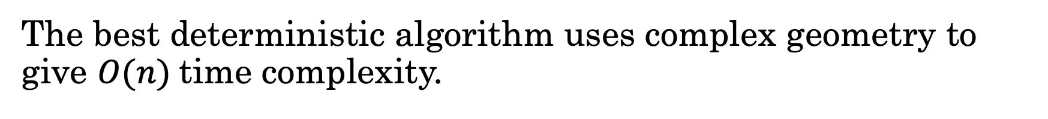
PROBLEM
Given n points in the plane, compute the smallest radius circle enclosing all n points.
The best deterministic algorithm uses complex geometry to give $O(n)$time complexity.

Slide 4
PROBLEM
Given n points in the plane, compute the smallest radius circle enclosing all n points.
The best deterministic algorithm uses complex geometry to give $O(n)$time complexity.
We present a simple randomized algorithm that matches this time complexity on expectation.

Slide 5
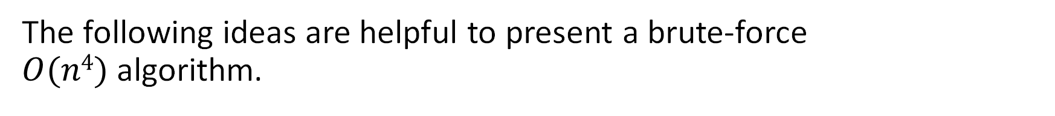
Towards an O(n⁴) algorithm
The following ideas are helpful to present a brute-force $O(n4)$algorithm.

Slide 6
Towards an O(n⁴) algorithm
The following ideas are helpful to present a brute-force $O(n4)$algorithm.
Uniqueness of the smallest enclosing circle.

Slide 7
Towards an O(n⁴) algorithm
The following ideas are helpful to present a brute-force $O(n4)$algorithm.
Uniqueness of the smallest enclosing circle.
Given n ≥ 2, the smallest enclosing circle contains at least two points on its circumference.

Slide 8
Uniqueness of the smallest enclosing circle

Slide 9
Consider two circles, C₁ (r, c₁) and C₂ (r, c₂) as the two smallest enclosing circle.

Slide 10
Consider another circle C passing through the intersection of two circles, centered at the midpoint of line joining C₁ and C₂ containing all points x ∊ C₁ ∩ C₂ .

Slide 11
The radius of C is $\sqrt{r^{2}−{\frac{(c1−c2)}{4}}^{2}}$ ≤ $\text{r}$.

Slide 12
The smallest enclosing circle contains at least two points on its circumference (for n ≥ 2)

Slide 13
Consider a circle with no points on its circumference.

Slide 14
This circle can be further shrunk to get a smaller circle that passes through one point while still enclosing all the points.

Slide 15
We can again move the center along the line joining center and the first point to get a smaller circle passing through two points.

Slide 16
We can again move the center along the line joining center and the first point to get a smaller circle passing through two points.

Slide 17
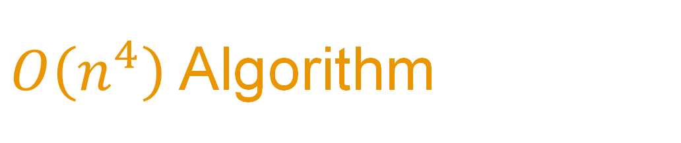
$O\left(n^{4}\right)$ Algorithm

Slide 18
Enclosing_Circle_N4([p₁,p₂,...p_{n}]){
C ← Circle with infinite radius
for i ← 1 to n do
for j ← i+1 to n do
C' ← Circle formed by taking p_{i}, p_{j} as ends of diameter
if C’.radius < C.radius and all_points_inside ( C') then
C ← C'
end
end
for i ← 1 to n do
for j ← i+1 to n do
for k ← j+1 to n do
C' = circumcircle ( p_{i} , p_{j} , p_{k} )
if C’.radius < C.radius and all_points_inside ( C' ) then
C ← C'
end
end
end
return C
}

Slide 19

Reducing the time complexity
We will now present lemmas that will help us to reduce the time complexity to $O\left(n^{3}\right)$.

Slide 20
Reducing the time complexity
We will now present lemmas that will help us to reduce the time complexity to $O\left(n^{3}\right)$.
The triangle formed by 3 defining points must be acute.

Slide 21
Reducing the time complexity
We will now present lemmas that will help us to reduce the time complexity to $O\left(n^{3}\right)$.
The triangle formed by 3 defining points must be acute.
The smallest enclosing circle for all points is the enclosing circle of any 3 points that form an acute angle triangle of maximum circumradius.

Slide 22
Defining Point of Smallest Enclosing Circle
A point that helps us “define” the smallest enclosing circle.

Slide 23
Defining Point of Smallest Enclosing Circle
A point that helps us “define” the smallest enclosing circle.
Defining points lie on the circumference of the smallest enclosing circle.

Slide 24
The triangle formed by 3 defining points must be acute.

Slide 25
Circle with three defining points.
Right Angled triangle

Slide 26
Circle with three defining points.
This is a case of two defining points.

Slide 27
Circle with three defining points.
Obtuse Angled triangle

Slide 28
Circle with three defining points.
Circle can be shrunk further to reduce the angle subtended.

Slide 29
Circle with three defining points.
Acute angle triangle

Slide 30
The smallest enclosing circle for all points is the enclosing circle of any 3 points that form an acute angle triangle of maximum circumradius.

Slide 31
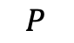
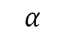
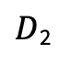
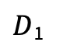
Let D₁ and D₂ be two defining points at some stage of the algorithm.
$$P$$
$$α$$
$D$₂
$D$₁

Slide 32
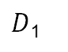
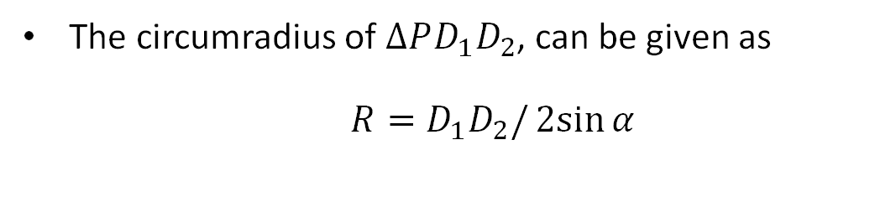
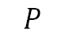
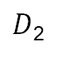
The circumradius of $∆PD_{1}D_{2}$, can be given as $R=D_{1}D_{2}/2sin{α}$
Let D₁ and D₂ be two defining points at some stage of the algorithm.
$$P$$
$$α$$
$D$₂
$D$₁

Slide 33
The circumradius of $∆PD_{1}D_{2}$, can be given as $R=D_{1}D_{2}/2sin{α}$
Let D₁ and D₂ be two defining points at some stage of the algorithm.
$$P$$
$$α$$
If the angle subtended by the chord on the boundary of the circle is least, then radius of the circumcircle is maximum as compared to all other points in the same sector.
$D$₂
$D$₁

Slide 34
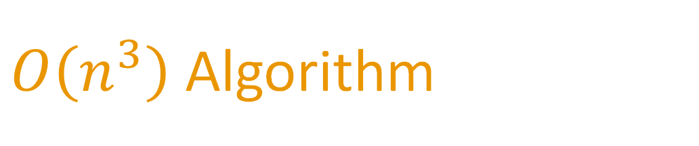
$O\left(n^{3}\right)$ Algorithm

Slide 35
Enclosing_Circle_N3([p₁,p₂,...p_{n}]){
C ← Circle with infinite radius
for i ← 1 to n do
for j ← i+1 to n do
C’ ← Circle(p_{i}, p_{j} )
if C’.radius < C.radius and C’ contains all points then
C ← C’
for i ← 1 to n do
for j ← i+1 to n do
C’ ← Circle(p_{i}, p_{j} )
for k ← j to n do
C” ← Circumcircle(p_{i}, p_{j} , p_{k})
if is_acute(C”) and C”.radius > C’.radius then
C’ ← C”
if C’.radius < C.radius and C’ contains all points then
C ← C’ return C
}

Slide 36
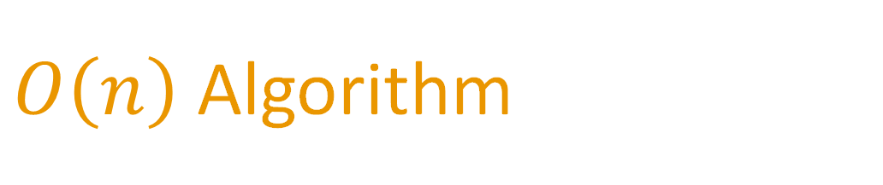
$O\left(n\right)$ Algorithm

Slide 37
Enclosing_Circle_N([p₁,p₂,...p_{n}]){
Permute P
C ← Circle Passing through p₁, p₂
for i ← 3 to n do
if p_{i} lies outside C then
C ← Circle(p₁, p_{i})
for j ← 1 to i do
if p_{j} lies outside C then
C ← Circle(p_{j}, p_{i})
for k ← 1 to j do
if p_{k} lies outside C then
C ← Circumcircle(p_{k}, p_{i}, p_{j})
return C
}

Slide 38
New Notations

Slide 39
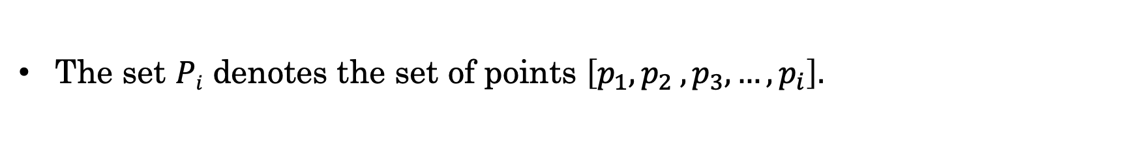
New notations
The set $Pi$ denotes the set of points $\left[p_{1},p_{2} ,p_{3}, …,p_{i}\right].$

Slide 40
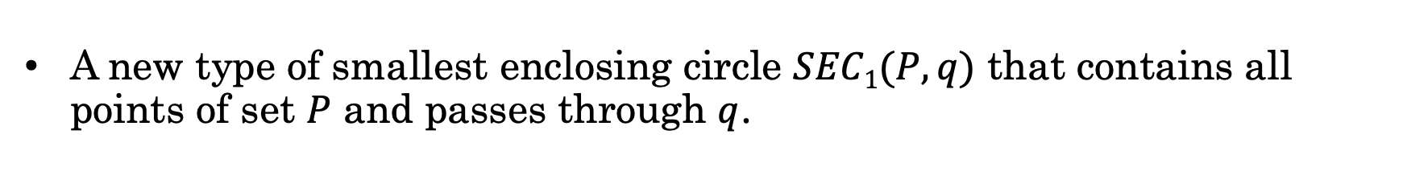
New notations
The set $Pi$ denotes the set of points $\left[p_{1},p_{2} ,p_{3}, …,p_{i}\right].$
A new type of smallest enclosing circle $SEC1(P, q)$ that contains all points of set $P$ and passes through $q$.

Slide 41
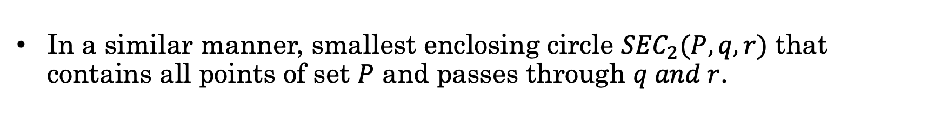
New notations
The set $Pi$ denotes the set of points $\left[p_{1},p_{2} ,p_{3}, …,p_{i}\right].$
A new type of smallest enclosing circle $SEC1(P, q)$ that contains all points of set $P$ and passes through $q$.
In a similar manner, smallest enclosing circle ${SEC}_{2}(P, q,r)$ that contains all points of set $P$ and passes through $q and r$.

Slide 42
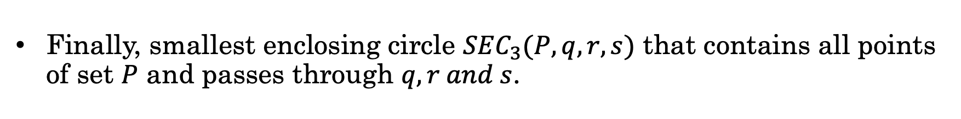
New notations
The set $Pi$ denotes the set of points $\left[p_{1},p_{2} ,p_{3}, …,p_{i}\right].$
A new type of smallest enclosing circle $SEC1(P, q)$ that contains all points of set $P$ and passes through $q$.
In a similar manner, smallest enclosing circle ${SEC}_{2}(P, q,r)$ that contains all points of set $P$ and passes through $q and r$.
Finally, smallest enclosing circle ${SEC}_{3}(P, q,r,s)$ that contains all points of set $P$ and passes through $q, r and s$.

Slide 43

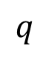
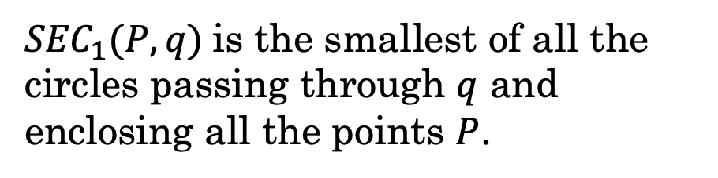
$$q$$
$$P$$
${SEC}_{1}(P, q)$is the smallest of all the circles passing through $q$ and enclosing all the points $P$.

Slide 44
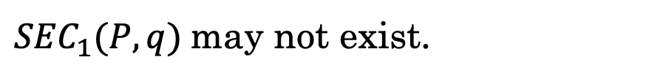
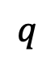

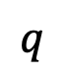
$$q$$
$$P$$
$$P$$
$$q$$
${SEC}_{1}(P, q)$is the smallest of all the circles passing through $q$ and enclosing all the points $P$.
${SEC}_{1}(P, q)$may not exist.

Slide 45
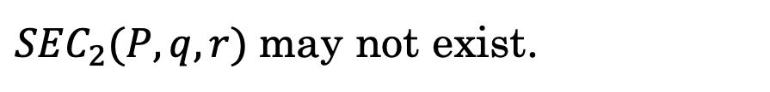

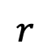
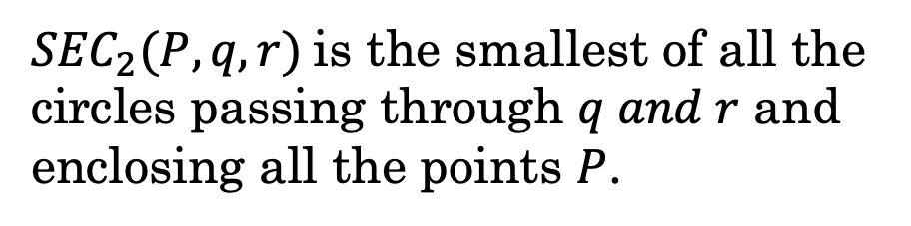
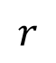

$$q$$
$$q$$
$$P$$
$$P$$
$$r$$
$$r$$
${SEC}_{2}(P, q,r)$is the smallest of all the circles passing through $q and r$ and enclosing all the points $P$.
${SEC}_{2}(P, q,r)$may not exist.

Slide 46

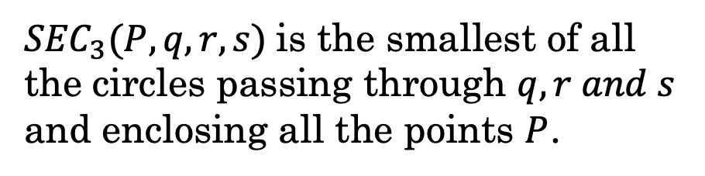
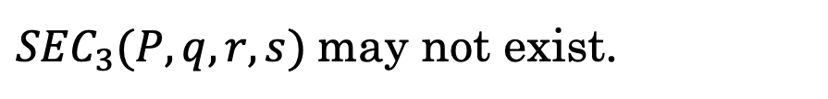
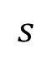
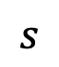
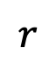
$$q$$
$$q$$
$$P$$
$$P$$
$$s$$
$$r$$
$$s$$
$$r$$
${SEC}_{3}(P, q,r,s)$is the smallest of all the circles passing through $q,r and s$ and enclosing all the points $P$.
${SEC}_{3}(P, q,r,s)$may not exist.

Slide 47
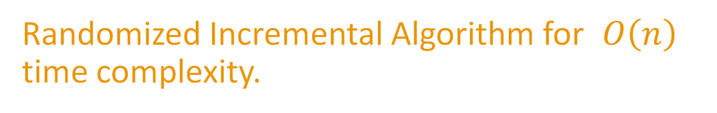
Randomized Incremental Algorithm for $O\left(n\right)$ time complexity.

Slide 48
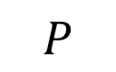
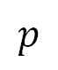
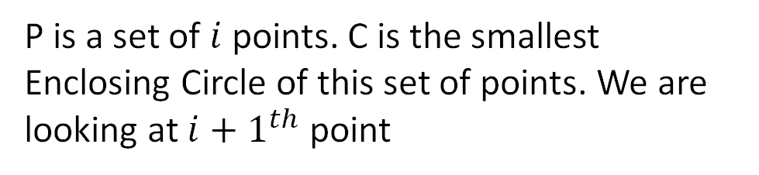
Randomized Incremental Construction
$$p$$
$$P$$
P is a set of $i$ points. C is the smallest Enclosing Circle of this set of points. We are looking at ${i+1}^{th}$ point

Slide 49
Randomized Incremental Construction
$$p$$
$$P$$
P is a set of $i$ points. C is the smallest Enclosing Circle of this set of points. We are looking at ${i+1}^{th}$ point
If the point lies inside. The smallest enclosing circle remains the same.

Slide 50
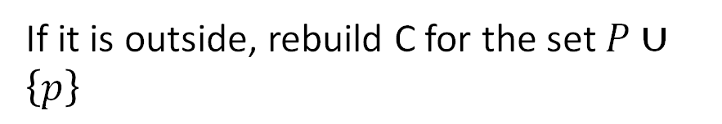
Randomized Incremental Construction
$$p$$
$$P$$
P is a set of $i$ points. C is the smallest Enclosing Circle of this set of points. We are looking at ${i+1}^{th}$ point
If the point lies inside. The smallest enclosing circle remains the same.
If it is outside, rebuild C for the set $P∪\left\{p\right\}$

Slide 51
Randomized Incremental Construction
Enclosing_Circle_N([p₁,p₂,...p_{n}]){
Permute P
C ← Circle(p₁, p₂)
for i ← 3 to n do
if p_{i} lies outside C
Update C
return C
}

Slide 52
First Defining Point.

Slide 53
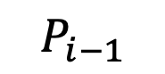
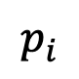

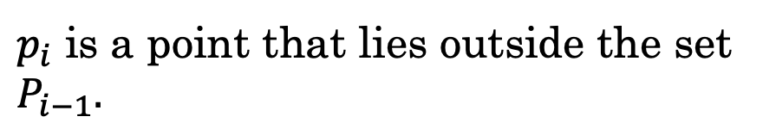
First defining point
$$p_{i}$$
$$P_{i−1}$$
$p_{i}$ is a point that lies outside the set $P_{i−1}.$
What makes $p_{i}$ special?

Slide 54
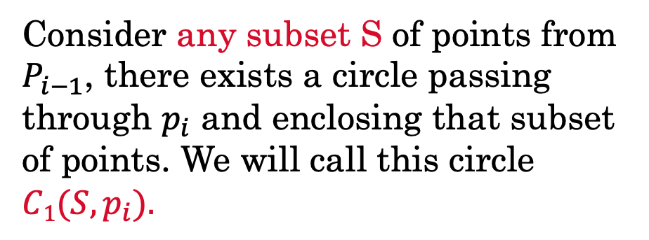
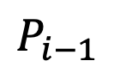
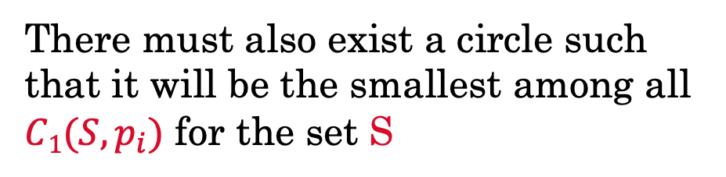
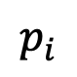
Consider any subset S of points from $P_{i−1}$, there exists a circle passing through $p_{i}$ and enclosing that subset of points. We will call this circle $C1(S, p_{i}).$
$$P_{i−1}$$
$$p_{i}$$
There must also exist a circle such that it will be the smallest among all $C1(S, p_{i})$ for the set S

Slide 55
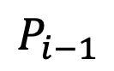
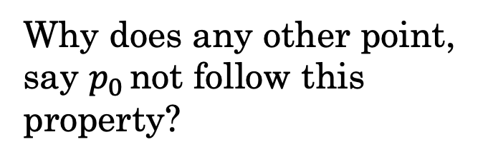

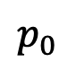
What makes $p_{i}$ special?
$$P_{i−1}$$
$$p_{i}$$
Why does any other point, say $p_{0}$ not follow this property?
$$p_{0}$$

Slide 56
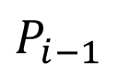
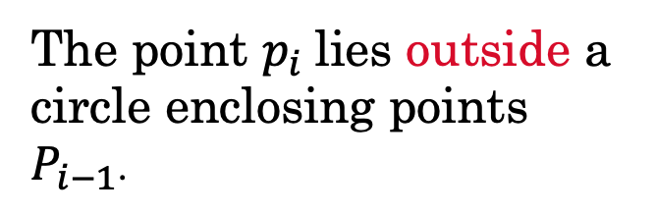
What makes $p_{i}$ special?
$$P_{i−1}$$
$$p_{i}$$
The point $p_{i}$lies outside a circle enclosing points $P_{i−1}$.
$$p_{0}$$

Slide 57
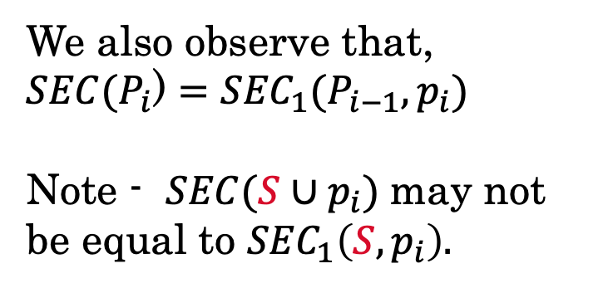
Observation
$$P_{i−1}$$
$$p_{i}$$
We also observe that,
$SEC(P_{i}$) $={SEC}_{1}(P_{i−1},p_{i})$
Note - $SEC(S∪p_{i})$may not be equal to ${SEC}_{1}\left(S,p_{i}\right).$

Slide 58
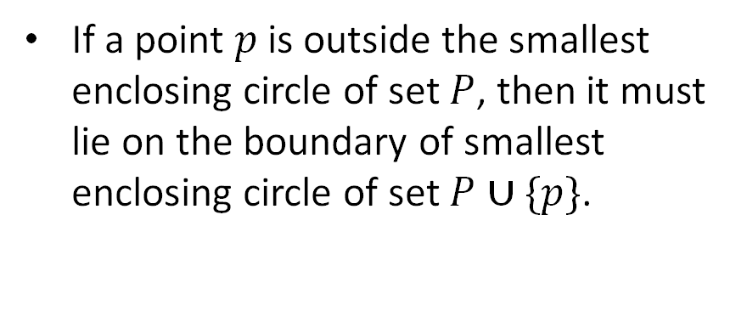
Outline of Proof
$$p$$
$$P$$
If a point $p$ is outside the smallest enclosing circle of set $P$, then it must lie on the boundary of smallest enclosing circle of set $P∪\{p\}$.

Slide 59


Intuition
Let’s assume that the smallest enclosing circle contains the point p inside it. Hence, the defining points for this circle must be taken from set P.
$$P∪\{p\}$$
$$P$$
$$p$$

Slide 60



Intuition
Let’s assume that the smallest enclosing circle contains the point p inside it. Hence, the defining points for this circle must be taken from set P.
$$P∪\{p\}$$
$$P$$
We can move the center of the new circle towards the common chord along the perpendicular bisector, as the triangle formed by the new set of defining points is obtuse.
$$p$$

Slide 61


Intuition
Let’s assume that the smallest enclosing circle contains the point p inside it. Hence, the defining points for this circle must be taken from set P.
$$P∪\{p\}$$
$$P$$
We can move the center of the new circle towards the common chord along the perpendicular bisector, as the triangle formed by the new set of defining points is obtuse.
$$p$$
The smallest enclosing circle for the set of points $P∪\left\{p\right\}$must pass through p.

Slide 62




Key idea
Angle subtended at the center of the circle is twice that of the angle subtended by the triangle
$$P$$
Since, the angle subtended by the longest side is always less than 180○ we always have $α>{90}^{○}$
$$α$$
$$2α$$
$$p_{}$$

Slide 63
Randomized Incremental Construction
Enclosing_Circle_N([p₁,p₂,...p_{n}])
{
C ← Circle(p₁, p₂)
P ← A list of all the points
for i ← 3 to n do
if p_{i} lies outside C
C ← Update(C)
return C
}

Slide 64
Randomized Incremental Construction
Enclosing_Circle_N([p₁,p₂,...p_{n}])
{
C ← Circle(p₁, p₂)
P ← A list of all the points
for i ← 3 to n do
if p_{i} lies outside C
C ← SEC₁(P_{i-1}, p_{i})
return C
}

Slide 65
Building the method $SEC1 (P_{i−1}, pi)$.

Slide 66
Randomized Incremental Construction
SEC₁(P_{i-1}, p_{i})
{
C ← Circle(p_{i})
for j ← 1 to i - 1 do
if p_{j} lies outside C
C ← Update(C)
return C
}

Slide 67
Second Defining Point

Slide 68





Second Defining Point
$$p_{i}$$
$p_{j}$ is a point that lies outside $SEC1(P_{j−1} , p_{i})$
$$p_{j−1}$$
$$p_{j}$$
What makes $p_{j}$ special?

Slide 69

Second Defining Point
$$p_{i}$$
c
Consider any subset S of points from $P_{j−1}$, there exists a circle passing through $p_{i}$ and $p_{j}$ enclosing that subset of points. We will call this circle $C_{2}(S, p_{i},p_{j}).$
$$p_{j−1}$$
$$p_{j}$$

Slide 70


Second Defining Point
c
$$p_{i}$$
c
Consider any subset S of points from $P_{j−1}$, there exists a circle passing through $p_{i}$ and $p_{j}$ enclosing that subset of points. We will call this circle $C_{2}(S, p_{i},p_{j}).$
$$p_{j−1}$$
$$p_{j}$$

Slide 71



Outline of proof
Let $C1(P_{j−1}, p_{i})$ be the circle that does not contain $p_{j}.$
$$p_{i}$$
$$p_{j}$$

Slide 72



Outline of proof
Let $C1(P_{j−1}, p_{i})$ be the circle that does not contain $p_{j}.$
$C1(P_{j}, p_{i})$exist since, $P_{j}$ $⊆ P_{i−1},$and let it not pass through $p_{j}$
$$p_{i}$$
$$p_{j}$$

Slide 73

Outline of proof
Let $C1(P_{j−1}, p_{i})$ be the circle that does not contain $p_{j}.$
$C1(P_{j}, p_{i})$exist since, $P_{j}$ $⊆ P_{i−1},$and let it not pass through $p_{j}$
$$p_{i}$$
$$p_{j}$$
We can move the center of $C1(P_{j}, p_{i})$towards the common chord along the perpendicular bisector.

Slide 74




What makes $p_{j}$ special?
$$p$$
$$q$$
$C_{2}\left(P,p,q\right)$does not exist since
$C1(P∪q ,p)$ does not exist.

Slide 75



What makes $p_{j}$ special?
$$p$$
$$q$$
$C_{2}\left(P,p,q\right)$does not exist since
no $C1(P,p)$ exist in which $q$ lies outside.

Slide 76
What makes $p_{j}$ special?
$$p$$
$$p$$
$$q$$
$$q$$
$C_{2}\left(P,p,q\right)$does not exist since
$C1(P∪q ,p)$ does not exist.
$C_{2}\left(P,p,q\right)$does not exist since
no $C1(P,p)$ exist in which $q$ lies outside.

Slide 77



What makes $p_{j}$ special?
$${SEC}_{1}(P_{j−1},p_{i})$$
$$p_{i}$$
But in our case, $C1(P_{j−1} ,p_{i})$ does not contain $p_{j}$and $C1(P_{j} ,p_{i})$ also exists.
$$p_{j}$$
$$SEC(P_{i−1})$$

Slide 78

Observation
We also observe that,
${SEC}_{1}(P_{j},$ $p_{i}$) $={SEC}_{2}(P_{j−1},p_{i},p_{j})$

Slide 79

Observation
We also observe that,
${SEC}_{1}(P_{j},$ $p_{i}$) $={SEC}_{2}(P_{j−1},p_{i},p_{j})$
Note :${ SEC}_{1}$($S∪p_{j}$, $p_{i}$) may not be equal to ${SEC}_{2}(S,p_{i},p_{j})$for $S$ being any subset of $P_{j−1}$

Slide 80



Outline of proof
$$p_{i}$$
$$p_{j}$$
$$P$$
If $p_{j}$ is outside ${SEC}_{1}(P,p_{i})$then $p_{j}$ must lie on the boundary of ${SEC}_{1}(P∪\left\{p_{j}\right\}, p_{i})$.

Slide 81






Key idea
Let’s assume that the smallest enclosing circle contains the point $p_{j}$ inside it. Hence, the defining points for this circle must be taken from set P.
$$p_{i}$$
$$P$$
$∠p_{i}p_{k}p_{}$ cannot be obtuse, since if that is the case, we can shift the center of the smallest enclosing circle along the direction of perpendicular bisector of longest side, $p_{i}p_{}$keeping all the points inside and $p_{i}$ on the boundary.
$$p_{k}$$
$$α$$
$$2α$$
$$p_{j}$$
$$p_{}$$

Slide 82
Randomized Incremental Construction
SEC₁(P_{i-1},p_{i})
{
C ← Circle(p_{i})
for j ← 1 to i - 1 do
if p_{j} lies outside C
C ← Update(C)
return C
}

Slide 83
Randomized Incremental Construction
SEC₁(P_{i-1},p_{i})
{
C ← Circle(p_{i})
for j ← 1 to i - 1 do
if p_{j} lies outside C
C ← SEC₂(P_{j-1},p_{i},p_{j})
return C
}

Slide 84
Building the method ${SEC}_{2} (P_{j−1}, pi$, $p_{j})$.

Slide 85
Randomized Incremental Construction
SEC₂(P_{j-1}, p_{i}, p_{j})
{
C ← Circle(p_{i}, p_{j})
for k ← 1 to j - 1 do
if p_{k} lies outside C
C ← Update(C)
return C
}

Slide 86
Third Defining Point

Slide 87






Third defining point
$${SEC}_{2}(P_{k−1}, p_{i},p_{j})$$
$$p_{i}$$
$$p_{j}$$
$p_{k}$ is a point that lies outside ${SEC}_{2}(P_{k−1} , p_{i},p_{j})$
What makes $p_{k}$ special?
$$p_{k}$$
$$SEC(P_{i−1})$$

Slide 88

Third defining point
$$p_{i}$$
$$p_{j}$$
Consider any subset S of points from $P_{k−1}$, there exists a circle passing through $p_{i}$ , $p_{j}$ and $p_{k}$ enclosing that subset of points. We will call this circle $C_{3}(S, p_{i},p_{j},p_{k}).$
$$p_{k}$$
$$SEC(P_{i−1})$$

Slide 89






Outline of proof
Let $C_{2}(P_{k−1}, p_{i},p_{j})$ be the circle that does not contain $p_{k}.$
$$p_{i}$$
$$p_{j}$$
Now,${ C}_{2}(P_{k}, p_{i},p_{j})$ exists, since $P_{k}$ $⊆ P_{j−1}$, and let it not pass through $p_{k}$
We can move the center of${ C}_{2}(P_{k}, p_{i},p_{j})$ towards the common chord along the perpendicular bisector.
$$p_{k}$$

Slide 90





What makes $p_{k}$ special?
$$p$$
$$q$$
$$r$$
$C_{3}(P,p,q,r).$ does not exist since
$C_{2}(P∪r ,p,q)$ ) does not exist.

Slide 91




What makes $p_{k}$ special?
$$p$$
$$q$$
$$r$$
$C_{3}(P,p,q,r)$ does not exist since no $C_{2}(P,p,q)$ exist where r lies outside.

Slide 92
What makes $p_{k}$ special?
$$p$$
$$q$$
$$p$$
$$q$$
$$r$$
$$r$$
$C_{3}(P,p,q,r).$ does not exist since
$C_{2}(P∪r ,p,q)$ ) does not exist.
$C_{3}(P,p,q,r)$ does not exist since no $C_{2}(P,p,q)$ exist where r lies outside.

Slide 93

What makes $p_{k}$ special?
$${SEC}_{2}(P_{k−1}, p_{i},p_{j})$$
$$p_{i}$$
$$p_{j}$$
But in our case${ C}_{2}(P_{k−1}, p_{i},p_{j})$ does not contain $p_{k}$ and ${ C}_{2}(P_{k}, p_{i},p_{j})$ also exist
$$p_{k}$$
$$SEC(P_{i−1})$$

Slide 94
Observation
We also observe that,
${SEC}_{2}(P_{k},$ $p_{i}, p_{j}$) $={SEC}_{3}(P_{k−1},p_{i},p_{j},p_{k})$

Slide 95


Outline of Proof
Now,${ SEC}_{2}(P_{k}, p_{i},p_{j})$ exists and let it not pass through $p_{k}$
$$p_{i}$$
$$p_{j}$$
$$p_{k−1}$$
$$p_{k}$$

Slide 96





Outline of Proof
Now,${ SEC}_{2}(P_{k}, p_{i},p_{j})$ exists and let it not pass through $p_{k}$
$$p_{i}$$
$$p_{j}$$
$$p_{k−1}$$
We can move the center of${ SEC}_{2}(P_{k}, p_{i},p_{j})$ towards the common chord along the perpendicular bisector, keeping $P_{k−1}$ inside to get $Circumcircle(p_{i},p_{j}$ $p_{k})$
$$p_{k}$$

Slide 97





This is${ SEC}_{2}\left(P_{k}, p_{i},p_{j}\right)$at the end of $k^{th}$ iteration.
$$p_{j}$$
$$p_{i}$$
$$p_{k−1}$$
$$p_{k}$$

Slide 98
Randomized Incremental Construction
SEC₂(P_{j-1}, p_{i}, p_{j})
{
C ← Circle(p_{i}, p_{j})
for k ← 1 to j - 1 do
if p_{k} lies outside C
C ← Update(C)
return C
}

Slide 99
Randomized Incremental Construction
SEC₂(P_{j-1}, p_{i}, p_{j})
{
C ← Circle(p_{i}, p_{j})
for k ← 1 to j - 1 do
if p_{k} lies outside C
C ← Circumcircle(p_{i}, p_{j}, p_{k})
return C
}

Slide 100
Enclosing_Circle_N([p₁,p₂,...p_{n}]){
Permute P
C ← Circle Passing through p₁, p₂
for i ← 3 to n do
if p_{i} lies outside C then
C ← Circle(p₁, p_{i})
for j ← 1 to i do
if p_{j} lies outside C then
C ← Circle(p_{j}, p_{i})
SEC₁(P,p)
for k ← 1 to j do
if p_{k} lies outside C then
C ← Circumcircle(p_{k}, p_{i}, p_{j})
return C
}

Slide 101
Enclosing_Circle_N([p₁,p₂,...p_{n}]){
Permute P
C ← Circle Passing through p₁, p₂
for i ← 3 to n do
if p_{i} lies outside C then
C ← Circle(p₁, p_{i})
for j ← 1 to i do
if p_{j} lies outside C then
C ← Circle(p_{j}, p_{i})
SEC₁(P,p)
for k ← 1 to j do
if p_{k} lies outside C then
C ← Circumcircle(p_{k}, p_{i}, p_{j})
return C
}
SEC₂(P,p,q)

Slide 102
Time Complexity Analysis

Slide 103
Lemma
Probability that point $P_{i}$ lies outside the smallest enclosing circle of points is $P_{1}$ , $P_{2}$ , $P_{3}$ , … , $P_{i−1}$ is ≤ $\frac{3}{i}$

Slide 104

Lemma
Probability that point $P_{i}$ lies outside the smallest enclosing circle of points is $P_{1}$ , $P_{2}$ , $P_{3}$ , … , $P_{i−1}$ is ≤ $\frac{3}{i}$
Using backward analysis,
If the Smallest Enclosing Circle is changed on adding the $i^{th}$ point, then $P_{i}$ must be one of the defining points of the Smallest Enclosing Circle of first $i$ points.

Slide 105

Lemma
Probability that point $P_{i}$ lies outside the smallest enclosing circle of points is $P_{1}$ , $P_{2}$ , $P_{3}$ , … , $P_{i−1}$ is ≤ $\frac{3}{i}$
Using backward analysis,
If the Smallest Enclosing Circle is changed on adding the $i^{th}$ point, then $P_{i}$ must be one of the defining points of the Smallest Enclosing Circle of first $i$ points.
There can be at most 3 defining points for this circle, so the probability that $i^{th}$ point is defining point is ≤ $\frac{3}{i}$.

Slide 106
Time Complexity Analysis
Expected time taken to find smallest enclosing circle with :

Slide 107
Time Complexity Analysis
Expected time taken to find smallest enclosing circle with :
$$O\left(1\right)+ \frac{3}{i}(time taken with one defining point known)$$
One defining point

Slide 108

Time Complexity Analysis
Expected time taken to find smallest enclosing circle with :
$$O\left(1\right)+ \frac{3}{i}(time taken with one defining point known)$$
One defining point
$$O\left(1\right)+ \frac{3}{j}(time taken with two defining point known)$$
Two defining points

Slide 109
Time Complexity Analysis
Expected time taken to find smallest enclosing circle with :
$$O\left(1\right)+ \frac{3}{i}(time taken with one defining point known)$$
One defining point
$$O\left(1\right)+ \frac{3}{j}(time taken with two defining point known)$$
Two defining points
Three defining points
$$O\left(j\right)$$

Slide 110
Time Complexity Analysis
Expected time taken to find smallest enclosing circle with :
$$O\left(1\right)+ \frac{3}{i}(time taken with one defining point known)$$
One defining point
Two defining points
$$O\left(i\right)$$
Three defining points
$$O\left(j\right)$$

Slide 111
Time Complexity Analysis
Expected time taken to find smallest enclosing circle with :
One defining point
$$O\left(n\right)$$
Two defining points
$$O\left(i\right)$$
Three defining points
$$O\left(j\right)$$

Slide 112
Experimental Results

Slide 113


Time taken by $O(n)$ , $O\left(n3\right)$ and $O(n4)$ algorithms
Number of Points | $O(n)$ Algorithm | $O(n3)$Algorithm | $O(n4)$Algorithm
10 | 1.65E-05 | 6.43E-05 | 0.0000780859058
100 | 4.70E-05 | 0.0422979618 | 0.1342413707
1000 | 0.000202330682 | 39.1849 | 1154.91
10000 | 0.00147525538 | -
100000 | 0.0146666224 | -
1000000 | 0.165364362 | -
10000000 | 2.25486684 | -

Slide 114

Time taken by O(n) algorithm
Number of Points | Mean Running time in Seconds
10 | 1.65E-05
100 | 4.70E-05
1000 | 0.000202330682
10000 | 0.00147525538
100000 | 0.0146666224
1000000 | 0.165364362
10000000 | 2.25486684

Slide 115

Memory used per iterations for linear time algorithm
Number of Points | Memory Used in Kilobytes
10 | 992
100 | 992
1000 | 1024
10000 | 1472
100000 | 4672
1000000 | 33088
10000000 | 290368

Slide 116

Number of times new point lies outside current circle
Number of Points | Average number of times point lies outside
10 | 3.37
100 | 9.57
1000 | 16.02
10000 | 23.02
100000 | 29.26
1000000 | 36.02
10000000 | 42.55

Slide 117

Density of Runtime in different ranges per unit mean runtime for $O(n)$ algorithm
 | 10 | 100 | 1000 | 10000 | 100000 | 1000000 | 10000000
0.25, 0.35 | 0 | 0 | 0 | 0 | 0 | 0 | 0
0.35, 0.45 | 0 | 0 | 0 | 0 | 0 | 0 | 0
0.45, 0.55 | 0 | 7 | 0 | 0 | 0 | 0 | 0
0.55, 0.65 | 12 | 34 | 36 | 0 | 0 | 0 | 0
0.65, 0.75 | 40 | 71 | 103 | 1 | 0 | 6 | 0
0.75, 0.85 | 65 | 74 | 96 | 73 | 69 | 75 | 6
0.85, 0.95 | 118 | 80 | 84 | 149 | 182 | 151 | 183
0.95, 1.05 | 87 | 55 | 48 | 141 | 132 | 133 | 190
1.05, 1.15 | 71 | 57 | 28 | 78 | 62 | 68 | 75
1.15, 1.25 | 54 | 29 | 19 | 30 | 26 | 37 | 30
N
n/N_{avg}
1.25, 1.35 | 20 | 27 | 13 | 15 | 9 | 9 | 9
1.35, 1.45 | 15 | 19 | 9 | 3 | 7 | 4 | 2
1.45, 1.55 | 8 | 16 | 11 | 2 | 3 | 4 | 3
1.55, 1.65 | 4 | 7 | 10 | 2 | 2 | 6 | 2
1.65, 1.75 | 1 | 10 | 11 | 1 | 2 | 3 | 0
>1.75 | 5 | 14 | 32 | 5 | 6 | 4 | 0

Slide 118


Slide 119

Comparison with worst case time for linear time algorithm
Number of Points | $$\text{Mean} \text{Running} \text{Time}$$ | Maximum Running Time | Standard Deviation
10 | 1.65E-05 | 5.42E-05 | 0.0000038761635
100 | 4.70E-05 | 1.15E-04 | 0.0000151004696
1000 | 0.000202330682 | 0.0007055 | 0.0000838130114
10000 | 0.00147525538 | 0.00431096 | 0.0002908786473
100000 | 0.0146666224 | 0.0723912 | 0.00411319448
1000000 | 0.165364362 | 0.564723 | 0.03456124655
10000000 | 2.25486684 | 3.56897 | 0.2534017665

Slide 120


Worst case is achieved in this orientation of points

Slide 121

Dry Run of the Algorithm. A visualizer was also made and can be found here.

Slide 122
Extension to higher dimensions.

Slide 123

Extension to higher dimensions.
For dimension $d>2$what does enclosing circle for a set of points $P$ means?
$$∀x∈P,{ ||x−c||}^{2} ≤r^{2}$$
where $c ∈ ℝ^{D}, r ∈ ℝ$ Smallest enclosing circle would mean minimizing r while enclosing P.

Slide 124

Extension to higher dimensions.
Number of Points | $1D$Algorithm | $2D$Algorithm | $3D$Algorithm
10 | 1.22E-05​ | 1.65E-05​ | 3.44E-05​
100 | 1.84E-05​ | 4.70E-05​ | 0.000192110254​
1000 | 0.00013828176​ | 0.000202330682​ | 0.00078098832​
10000 | 0.00137167392​ | 0.00147525538​ | 0.0037308135​
100000 | 0.0129595706​ | 0.0146666224​ | 0.0245849624​
1000000 | 0.13684679​ | 0.165364362​ | 0.245878112​
10000000 | 1.9767855​ | 2.25486684​ | 3.06615678​

Slide 125


